Slide 1
Accreditation – it’s for all of us!
(Especially Teacher Librarians)
Margo Pickworth, Teacher Librarian, Shore Preparatory School, North Sydney
Highly Accomplished Teacher, ASLA Board member

Slide 2
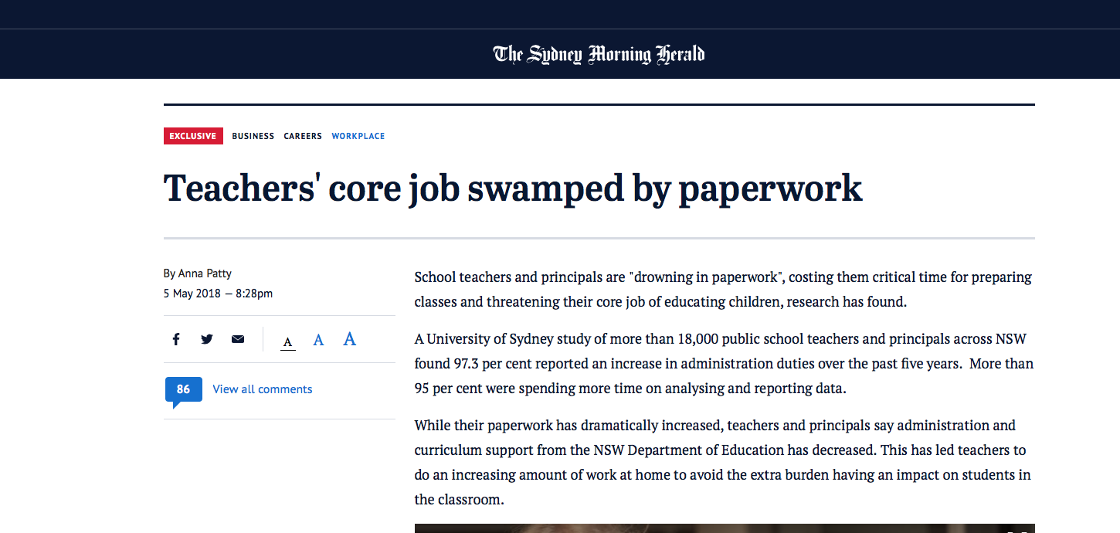
‘From 1 January 2018 all teachers must be accredited by NESA to start, continue, or return to teaching in a school or early childhood service in NSW.’
(http://educationstandards.nsw.edu.au/wps/portal/nesa/teacher-accreditation/how-accreditation-works/your-accreditation)
How do we get the balance?

Slide 3
AIM OF THIS SESSION
Overview of the NESA process of NSW teacher accreditation
Australian Professional Standards for Teachers
Explain the Maintenance cycle
The impact on our Professional Development
Higher levels of accreditation
Available support
Answer any questions

Slide 4
ABOUT ME
Committed and qualified Teacher Librarian at Shore
Highly Accomplished Teacher
Leadership opportunities – mentoring, writing, presenting, consulting…….
ASLA Board member of the Australian School Library Association

Slide 5
Melbourne Declaration on Educational Goals for Young Australians
AITSL Australian Institute for Teaching and School Leadership
APST Australian Professional Standards for Teachers
NSW Institute of Teachers
Institute merged with BOSTES - Board of Studies
NESA NSW Education Standards Authority
2008
2010
2011
2016
2018

Slide 6
Established 2010
National body focusing on Teaching standards and school leadership
https://www.aitsl.edu.au/

Slide 7
Replaced BOSTES on 1/1/18
Monitors ‘quality teaching, learning, assessment and school standards’ across all NSW schools
Accreditation of all teachers and teaching degrees

Slide 9
CAREER STAGES
Graduate Teacher
Learning how to make a difference to students
Proficient Teacher
Making a difference to your students
Highly Accomplished Teacher
Making a difference to your students + students next door
Lead Teacher
making a difference to your students + students next door + school next door

Slide 10
‘the STANDARDS’
4 Career stages
3 Domains of teaching
7 Teaching Standards
37 Standard Descriptors

Slide 11
Standard Descriptors
1.1.1
Standard 1
Descriptor 1
Level: Graduate Teacher
Demonstrate knowledge and understanding of physical, social and intellectual development and characteristics of students and how these might affect learning.
4.5.4
Standard 4,
Descriptor 5
Level: Lead Teacher
Review of implement new policies and strategies to ensure the safe, responsible and ethical use of ICT in learning and teaching

Slide 12
Where are we at?
Teachers trained before 2004 are now Proficient teachers
If recent Graduates will have gone through Graduate to Proficient teacher

Slide 13
How do you move through the Career Stages?
Provide evidence
Referees
Direct observation
Documentary evidence
Principal approval
Submitted to the TAA

Slide 14
Maintenance of Accreditation
Cycles of 5 years for full-time teachers
Cycles of 7 Years for part-time teachers
100 hours of Professional Development

Slide 15
100 hours of professional development
50 hours:
NESA Accredited PD
Ensuring that your teaching practice aligns with the teaching standards
50 hours:
TIPD – Teacher Identified PD
Enhancing your teaching through professional development

Slide 16
Teacher Identified or NESA accredited?
Teacher Identified | NESA Accredited
Can be: Courses, workshops, seminars Professional reading Planning/delivering professional learning Observing a teacher or colleague’s teaching | Courses with NESA symbol
NOT activities that are expected in the normal teaching duties eg writing reports | Will highlight which Standard is being addressed

Slide 17
Teacher Identified PD – what do you think?
Procedural meeting
Reading a text on G I
Attending a TL network meeting
Guest speaker & Follow up notes
Going on an excursion
Attending today’s Conference

Slide 18
Teacher Identified PD – what do you think?
Procedural meeting
Reading a journal article in ACCESS
Attending an ASLA Conference
Attending Art Gallery info afternoon
Marking the roll
Attending an ASLA Webinar

Slide 19
https://www.youtube.com/watch?v=QllfHkBmHQE

Slide 20
MAKING NESA YOUR FRIEND! http://educationstandards.nsw.edu.au/wps/portal/nesa/home
Log in, select Teacher Accreditation

Slide 21
Search for NESA accredited PD courses

Slide 22
NESA Accredited PD
ASLA (Australian School Library Association)
Search by:
Name
Standard
Delivery
Provider

Slide 23
TEACHER IDENTIFIED PD
Add:
Activity
Time/Type
Date
How did it meet Standards?

Slide 24
MAINTENANCE TIPS
Make sure you have a NESA number – keep it handy!
Give the provider your number, evaluate after completion
Complete as you go, don’t leave till last minute

Slide 25
HIGHER LEVELS OF ACCREDITATION
National Certification - Highly Accomplished Teacher OR Lead Teacher
Described as a ‘significant’ career decision
Join the HALT network

Slide 26
Steps to think about BEFORE YOU BEGIN
Know the Standards
Talk to your Principal
Online preliminary assessment
Collect your evidence

Slide 27
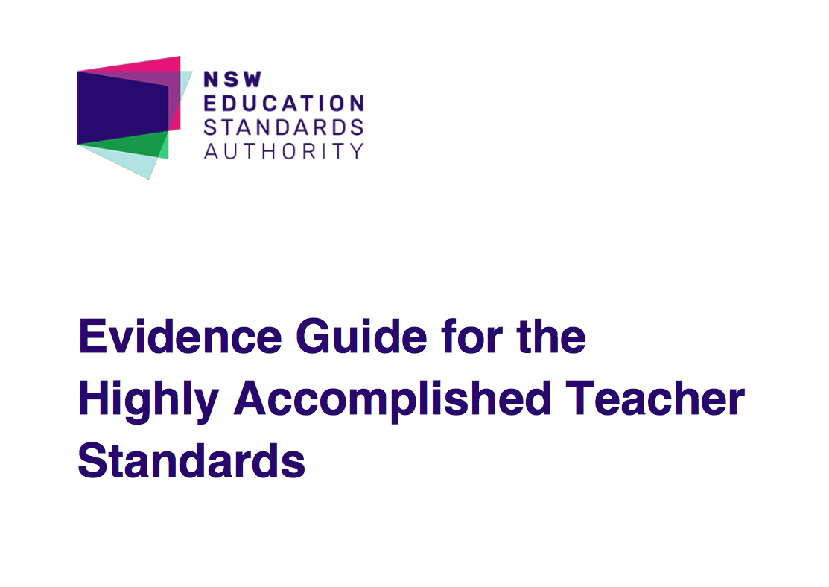
EVIDENCE GUIDES
Evidence:
Observation
Referees
Documentary Evidence

Slide 28
Video 1: Mark Downie, TL, Fairfield High
ACTIVITY:
Match the Evidence with the most appropriate Descriptor
Video 2: Kerry Pope, Highly Accomplished Teacher

Slide 29
HOW CAN ASLA ASSIST YOU?
Become a member
Our courses/conference are NESA accredited
Read Evidence Guides on ASLA website
Attend a webinar, Deliver a webinar
Read ACCESS, Contribute to ACCESS
National Certification project team has been formed – email us!
Attend our Conference Canberra, April, 2019
Become Board member, Part of a Project Team

Slide 30
Why we should embrace it?
Ultimately teacher librarians are teachers – we need to get involved
It will reinforce our role as valuable members of the learning team
Valuable personal and professional experience, particularly if you pursue higher levels of accreditation

Slide 31
TEACHING STANDARDS IN ACTION
https://www.youtube.com/watch?v=UMb6RUX7Kfg
TEACHING STANDARDS IN ACTION

Slide 32
Make sure you are At The TaBLe
‘ If you are not at the table, you are on the menu”!

Slide 33
ANY QUESTIONS?
CONTACT DETAILS:
Margo Pickworth
mpickworth@shore.nsw.edu.au

